Slide 1
MODELLING INTERNAL STATES OF PEOPLE WITH BPD
Maria Hotoiu
Federico Tavella
Group 5

Slide 2
OUTLINE
Overview
Neurological background
Temporal-causal model
Conceptual representation
Numerical representation
Simulation results
Parameter tuning
Analysis

Slide 3
Overview
1
What is Bipolar Personality Disorder?

Slide 4
Borderline personality disorder is a mental illness marked by an ongoing pattern of varying moods, self-image, and behavior.
People with borderline personality disorder may experience intense episodes of anger, depression, and anxiety that can last from a few hours to days.

Slide 5
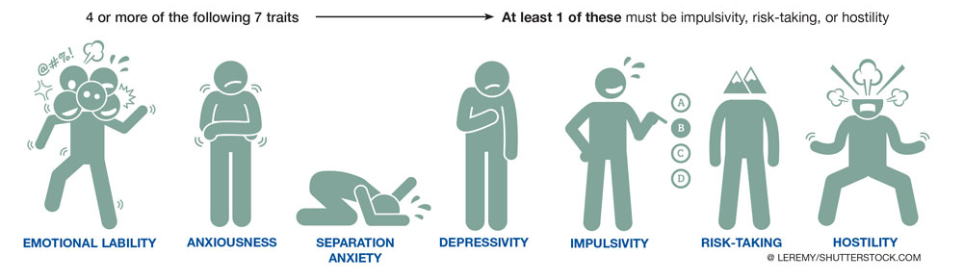
BPD

Slide 6
BPD
Symptoms
Swinging mood
Intense/inappropriate anger
Feeling of dissociation
Depression
Distorted/unstable image of self
Extreme categorization
Fear of abandonment
Consequences
Unstable relationships
Self-harming behaviour
Suicidal thoughts

Slide 7
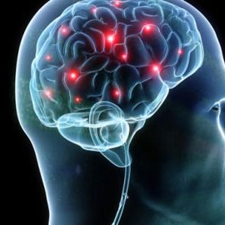
BPD
BPD is associated with structural and functional changes in the brain
Risk factor or cause?

Slide 8
Neuropsychological background
2
How can the behaviour of people with BPD be explained?

Slide 9
BACKGROUND
Identity diffusion (De Meulemeestera et al., 2016)
No engagement of the cognitive control regions when employing a distancing strategy to regulate emotional reactions (Koenigsberg et al., 2010)
Lower levels of self-reported trust relative to healthy controls, as well as negative expectations of social partners (King-Casas et al., 2008)
Tendency to attribute behavior to traits rather than context (Homan et al., 2017)

Slide 10
Temporal-causal network model
3

Slide 11
TEMPORAL-CAUSAL NETWORK MODEL
It must include
Empathic responding using mirror neurons, self-other distinction and emotion integration
Control neurons with self-other distinction and control function
Regulation of enhanced sensory processing sensitivity
Mirror neurons system
Emotion integration

Slide 12
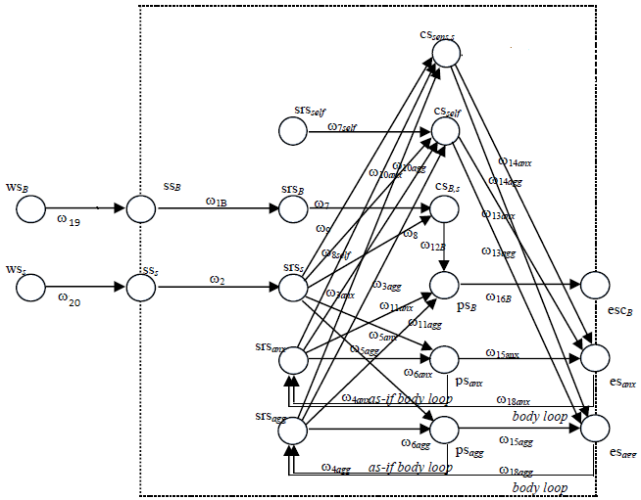
CONCEPTUAL REPRESENTATION

Slide 13
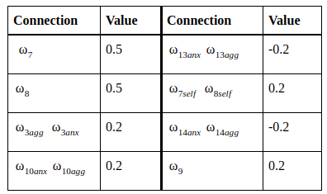
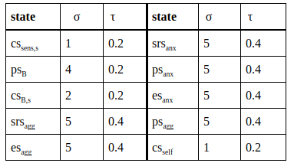
PARAMETERS

Slide 14


NUMERICAL REPRESENTATION

Slide 15
Simulation results
4

Slide 16
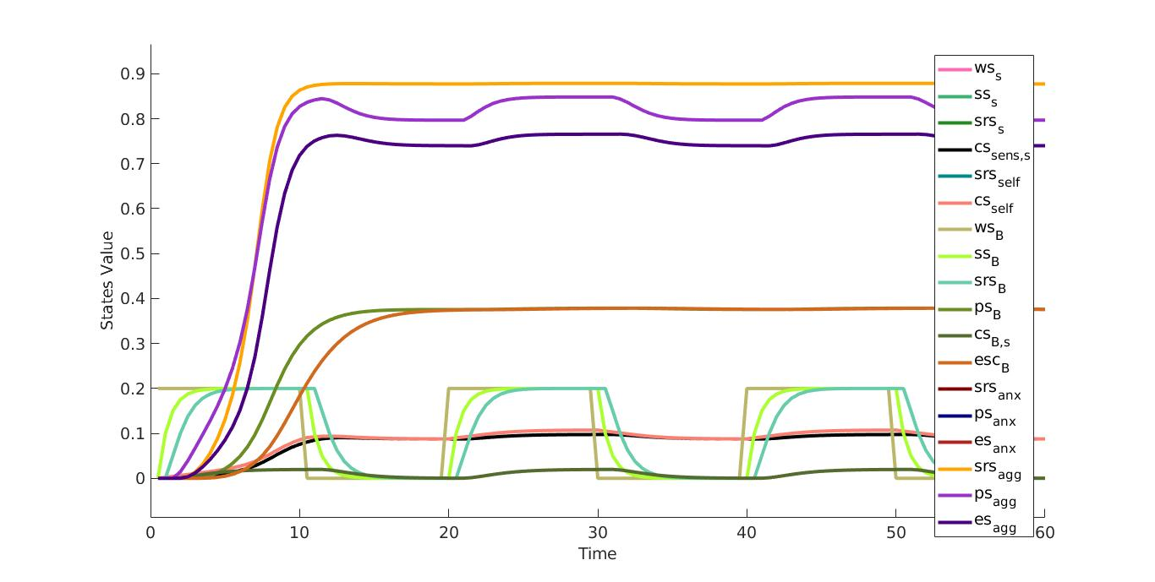
SIMULATION

Slide 17
Parameters tuning
5

Slide 18
PARAMETER TUNING
Simulated annealing
Exhaustive search

Slide 19
Analysis
6

Slide 20
NUMERICAL ANALYSIS
18 equilibrium equations
Stationary points at minimum and maximum values

Slide 21
THANKS!
Any questions?
You can find us at
m.hotoiu, f.tavella
@student.vu.nl

Slide 22
SlidesCarnival icons are editable shapes.
This means that you can:
Resize them without losing quality.
Change fill color and opacity.
Change line color, width and style.
Isn’t that nice? :)
Examples:

Slide 23
😉
Now you can use any emoji as an icon!
And of course it resizes without losing quality and you can change the color.
How? Follow Google instructions https://twitter.com/googledocs/status/730087240156643328
✋👆👉👍👤👦👧👨👩👪💃🏃💑❤😂😉😋😒😭👶😸🐟🍒🍔💣📌📖🔨🎃🎈🎨🏈🏰🌏🔌🔑 and many more...

